Slide 1
RESEARCH AND DEVELOPMENT CS402

Slide 2
Run-time conversion of speech from one language to another using deep learning
Mentors: Prof. Prosenjit Gupta
Mr. Vikas Malviya

Slide 3
GROUP MEMBERS
Deeptonabho Dutta | U101116FCS030
Gaurav Mundhra | U101116FCS037
K.N Raviteja | U101116FCS056
Sabyasachi Mishra | U101116FCS104
Shubhangi | U101116FCS127

Slide 4
CONTENTS
Rationale of work
Objective
Results of the work done
Future work
Difficulty

Slide 5
Objectives of the Study
Objective 1: To implement the project using machine learning libraries
Objective 2: To switch from machine learning libraries to deep learning libraries and neural nets
Speech Recognition:
Deepspeech and Tensorflow (or) HMM model
Speech Translation:
Tensorflow, NLTK and Keras
Speech Synthesis:
Tensorflow ,Matplotlib and Tensorboard

Slide 6
Rationale of the Study
Language is a genuine problem when difficult to understand. Through our research, we aim to considerable solve the following problems:
Lingual Barrier - To make language easy to understand and also to widen our knowledge in the fields of machine learning and deep learning.
Conferences - To make speeches in international conferences accessible to all the dignitaries.
Education - To instantaneously translate a teacher’s lecture to different languages in a classroom.
Tourism – To enable a tourist to communicate effectively with people in a new country.
Blind People - To translate on-screen text to a blind person’s native language.

Slide 7
Rationale of the Study (Continued)
Why not use previous models
Pre-1970
Speech recognition was implemented for less vocabulary of words(16-200 words).
User had to give a pause after every word for the system to recognize.
1970-2000
Introduction of HMM model.
30 seconds of speech required 100 minutes to be translated into another language.
2000s
Introduction of LSTM which outperforms HMM models.
There was a increase in the performance and decrease in word error

Slide 8
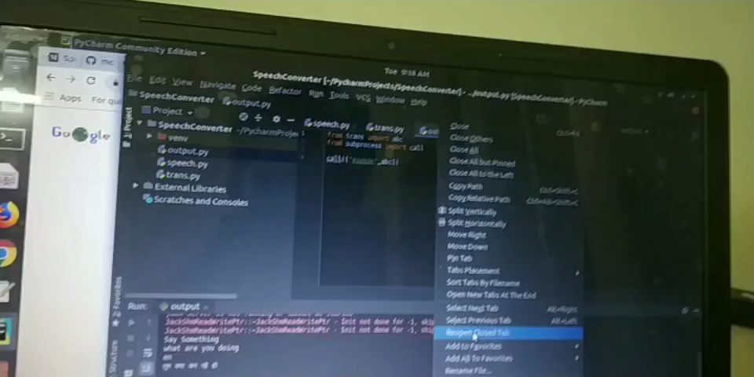
Results of the work done: Machine learning
Successfully implemented with ML libraries and noted the Shortcomings -
Output is not that accurate
Bad quality microphone is prone to noise
Not real time

Slide 9

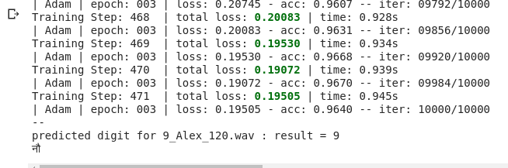
Results of the work done: Deep learning
(Continued)

Slide 10
Results of the work done: Deep learning
Speech Recognition
In this approach we build an LSTM recurrent neural network using the TFLearn high level Tensorflow-based library to train on a labeled dataset of spoken digits. Then we test it on spoken digits
We label the Dataset with the help of the extracted features (Frequency and width) from the .wav file and perform classification for phoneme
This module is almost complete as there are few errors while training the model due to lack of high end GPU (RTX 1080 8 gb)
Notes:
Used SVM:support vector machine. -Sound wave:sample.
SVM: Removes the overfitting problem as well as noise.

Slide 11
Results of the work done: Deep learning
Speech Synthesis
We use a TTS engine
In this approach we convert raw text containing symbols like numbers and abbreviations into the equivalent of written-out words
we assigns phonetic transcriptions to each word .
Converting the symbolic linguistic representation into sound .
Yet to implement
Notes:
TTS:text to speech.

Slide 12
Results of the work done: Deep learning
Speech Translation :
We use Neural MachineTranslation:
RNN Encoder–Decoder : It consists of two recurrent neural networks (RNN) that act as an encoder and a decoder pair.
The encoder maps a variable-length source sequence to a fixed-length vector, and the decoder maps the vector representation back to a variable-length target sequence.

Slide 13
Future work
Mastering the skills required in order to overcome the errors faced.
Implementing the other two phases(Translation, Synthesis) using deep learning with large corpus and high-end GPU.
Modifying the model according to our novelty for better performance.

Slide 14
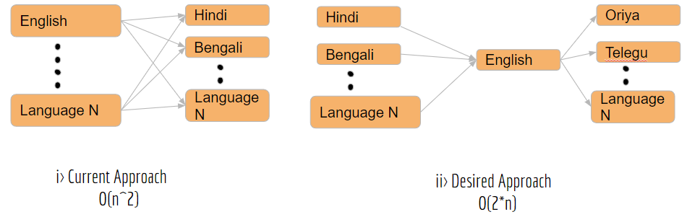
Novelty
We have decided to train our model with human voice signal so that the synthesis becomes more real and with emotions.
We plan on using English as an intermediate language for optimizing the complexity from O(n^2) to O(2*n)

Slide 15
Difficulties faced
Getting the required Dataset.
Need of high-end GPU and good quality microphone.
Problem using google colab.

Slide 16
References
Alex Waibel,Gate Alon Lavie, Lori Levin, Kevin Lenzo, Laura Mayﬁeld Tomokiyo Juergen Reichert, “two-way sequence to sequence translator”, NAACL-Demonstrations '03 Proceedings of the 2003 Conference of the North American Chapter of the Association for Computational Linguistics on Human Language Technology: Demonstrations - Volume 4,Pages 29-30,Edmonton, Canada — May 27 - June 01, 2003.
Yonghui Wu, Mike Schuster, Zhifeng Chen, Quoc V. Le, Mohammad Norouzi, “Google’s Neural Machine Translation System: Bridging the Gap between Human and Machine Translation”, Google ,September 26, 2016 Problem using google colab.
Kyunghyun Cho, Bart van Merrienboer, Caglar Gulcehre, Dzmitry Bahdanau, Fethi Bougares, Holger Schwenk, Yoshua Bengio, “Learning Phrase Representations using RNN Encoder–Decoder for Statistical Machine Translation”, Proceedings of the 2014 Conference on Empirical Methods in Natural Language Processing (EMNLP), Doha, Qatar, October 2014
Li Deng ,Xiao Li,“Machine Learning Paradigms for Speech Recognition: An Overview”, IEEE Transactions on Audio Speech and Language Processing ,Volume 21(5): Pages -1060-1089 ,May 2013

